Slide 1
Does the difference between square area and surface area have a effect on the survival of empires

Slide 2
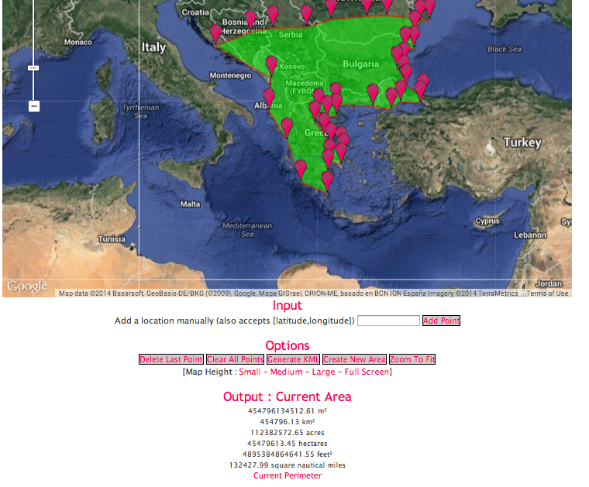
Using a tool called Google earth area calculator I can find the perimeter and area of any place on the planet.

Slide 3
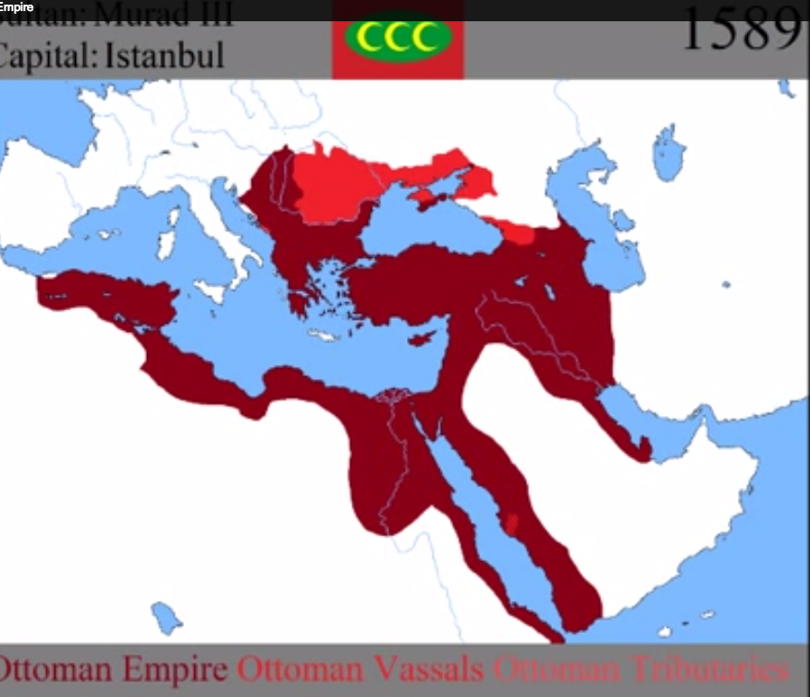
I get the year by year data from a historical YouTube channel that post videos of the spread of empires using data from many credible sources [like the Smithsonian].

Slide 4
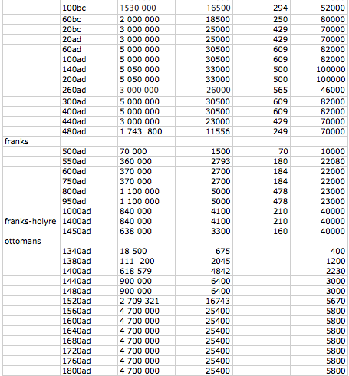
I have collected the data on a excel sheet on the data on four empires: roman, Frankish, ottoman, Holy roman. All in different time periods.
I have recorded the perimeter, the square area and the defensive perimeter.
The defensive perimeter is what the empire would actually have to defend.

Slide 5
Problems
I had major trouble find year by year maps of the spread of the different empires.
Finding software that could calculate the area was also a problem.

Slide 6
conclusion
Of all these successful empires there was a common factor to the success
When a empire reaches a perimeter/area ration of 400:1 the empire is considered to be in it’s “golden age”
I believe that this is because of the amount of people that the empire can feed. This mean more people to defend the empire.

Slide 7
What next?
I can use this data to complement other questions that I may ask.
Perhaps I will do a project on the climate of each region.

